Slide 1
Learning Objective
I will be able to apply differentiation to maximum and minimum problems
Success Criteria
At the end of the lesson, I will be able to:
Apply differentiation to maximum and minimum problems.

Slide 2





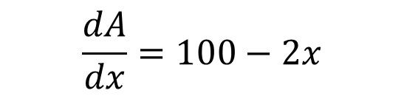



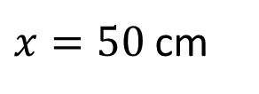
Guided Practice
$$2x+2y=200$$
$$y=100−x$$
$$A=xy$$
$$A=x(100−x)$$
$$A=100x−x^{2}$$
$$\frac{dA}{dx}=100−2x$$
To find the maximum/minimum points, equate derivative =0
$100−2x=0$
$$A=50(100−50)$$
$x=50$ cm
$$A=2500 cm^{2}$$
For maximum area to occur, length has to be 50 cm

Slide 3









Guided Practice
$$y=2−x$$
$$f(x)=x^{2}+y^{2}$$
$$=x^{2}+{(2−x)}^{2}$$
$$=x^{2}+4−4x+x^{2}$$
$$f(x)={2x}^{2}−4x+4$$
$$f^{′}\left(x\right)=4x−4$$
$$4x−4=0$$
$$x=1$$
$$f\left(1\right)=2$$
The minimum value is 2

Slide 4
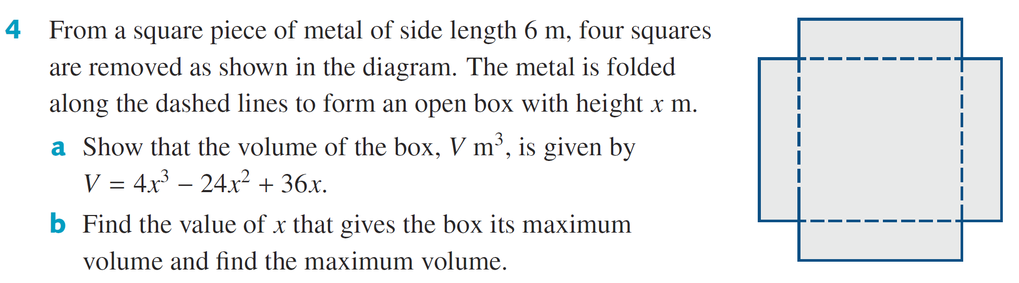
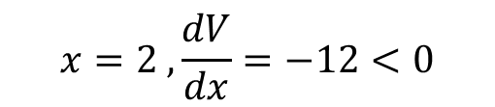

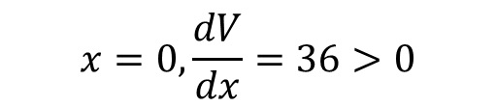








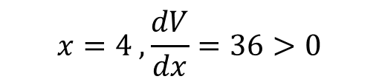

Guided Practice
a) $V=Area of base ×Height$
$$V={x\left(6−2x\right)}^{2}$$
Determine which will stationary point will be a maximum point
$$V=x(36−24x+4x^{2})$$
$$x=0,\frac{dV}{dx}=36>0$$
$$V=4x^{3}−{24x}^{2}+36x$$
$$x=2 ,\frac{dV}{dx}=−12<0$$
b) $\frac{dV}{dx}=12x^{2}−48x+36$
$$x=4 ,\frac{dV}{dx}=36>0$$
$$12x^{2}−48x+36=0$$
$$x^{2}−4x+3=0$$
$$V=4{\left(1\right)}^{2}−24{\left(1\right)}^{2}+36=16 m^{3}$$
$$\left(x−3\right)\left(x−1\right)=0$$
$$x=1, x=3$$
Max volume is $V=16m^{3}$ at x=1 m

Slide 5
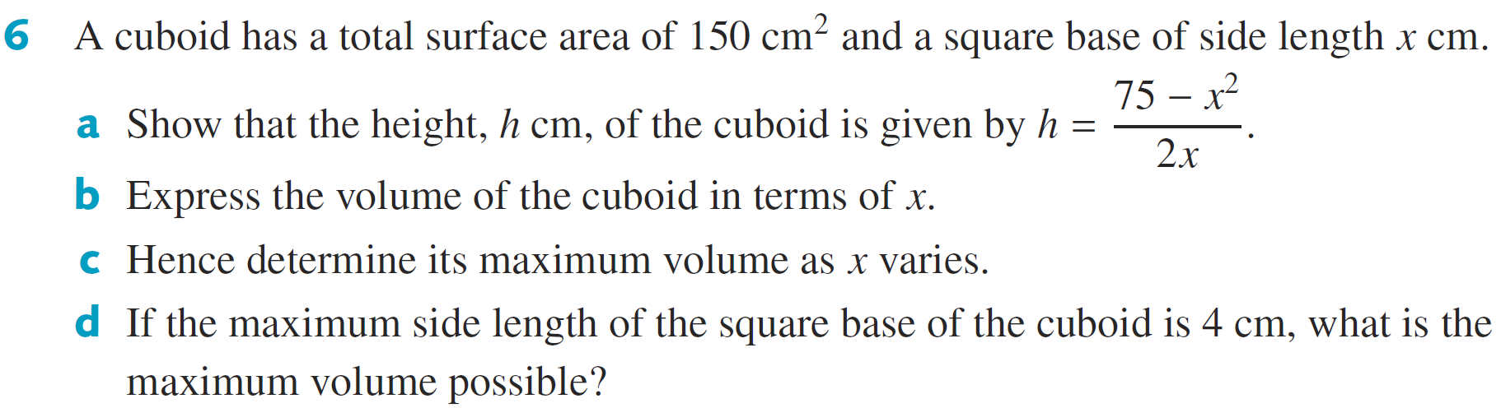


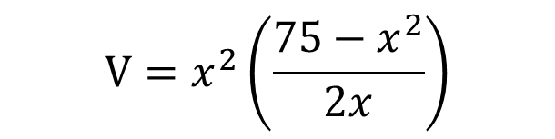
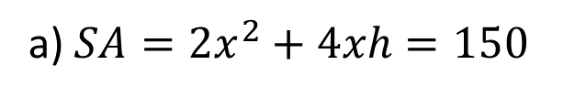
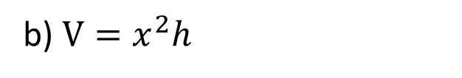



Guided Practice
$$V=\frac{x}{2}\left(75−x^{2}\right)$$
a) $SA=2x^{2}+4xh=150$
$$x^{2}+2xh=75$$
$$V=\frac{75x}{2}−\frac{x^{3}}{2}$$
$$2xh=75−x^{2}$$
$$h=\frac{75−x^{2}}{2x}$$
b) $V=x^{2}h$
$$V=x^{2}\left(\frac{75−x^{2}}{2x}\right)$$

Slide 6
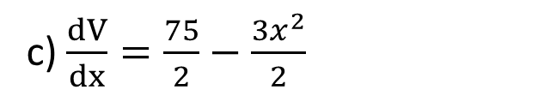






Guided Practice
$$V=\frac{75x}{2}−\frac{x^{3}}{2}$$
c) $\frac{dV}{dx}=\frac{75}{2}−\frac{{3x}^{2}}{2}$
$$\frac{75}{2}−\frac{{3x}^{2}}{2}=0$$
$$(75−{3x}^{2})=0$$
$$x=5, x=−5$$
$$V=125 cm^{3}$$
d) When x = 4, $V=118 cm^{3}$

Slide 7











Guided Practice
$$f^{′}\left(x\right)=−16x$$
$$−16x=0$$
$$x=0$$
$$y=2$$
$(0,2)$ is a stationary point
$$f^{′}\left(−1\right)=16>0$$
$$f^{′}\left(1\right)=−16<0$$
$(0,2)$ is a maximum point
Sketch the graph of $f\left(x\right)=2−8x^{2}$ for domain [-2, 2]
Absolute max = 2
$$f\left(−2\right)=−30$$
Absolute min = -30
$$f\left(2\right)=−30$$

Slide 8












Guided Practice
$$f^{′}\left(x\right)=6x^{2}−12x$$
$$f\left(4\right)=32$$
$$6x^{2}−12x=0$$
$$6x(x−2)=0$$
$$x=0, x=2$$
$$f\left(0\right)=0, f\left(2\right)=−8$$
$\left(0,0\right)and \left(2, −8\right)$ are stationary points
$$f^{′}\left(−1\right)=18>0$$
$$f^{′}\left(1\right)=−6<0$$
Absolute max = 32
$$f^{′}\left(3\right)=18>0$$
Absolute min = -8
$\left(0,0\right)$ is a maximum stationary point
$\left(2,−8\right)$ is a minimum stationary point

Slide 9
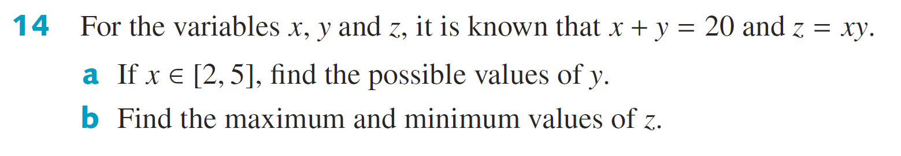


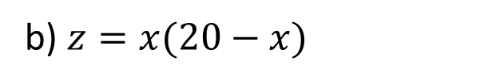
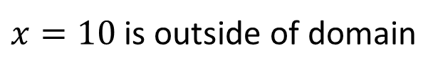
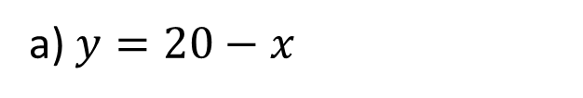







Guided Practice
a) $y=20−x$
$$y=20−2=18$$
$$y=20−5=15$$
$$y∈[15,18]$$
b) $z=x(20−x)$
$$z=20x−x^{2}$$
$$\frac{dz}{dx}=20−2x$$
$$20−2x=0$$
$$x=10, z=100$$
When $x=2, z=36$ -> Minimum
$x=10$ is outside of domain
When $x=5, z=75$ -> Maximum

Slide 10
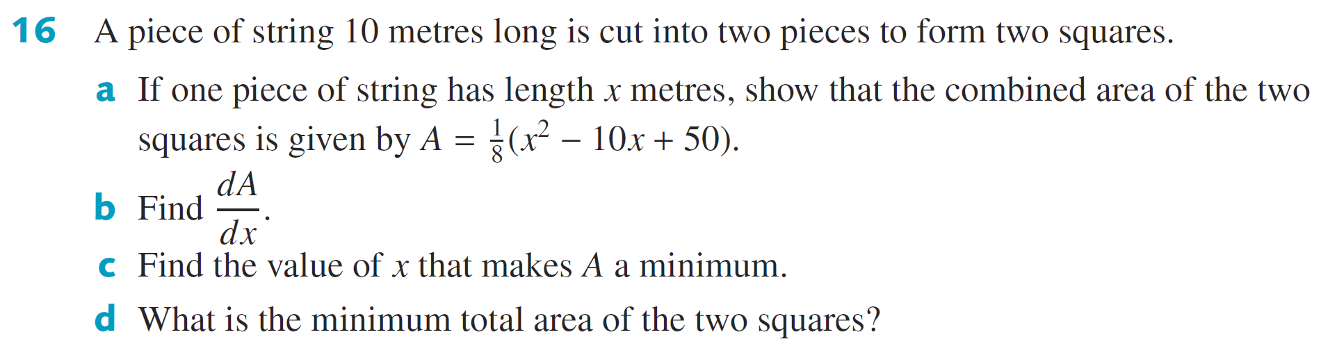


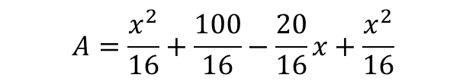

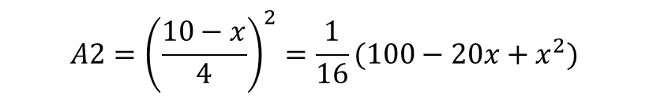



Guided Practice
a) $A1={\left(\frac{x}{4}\right)}^{2}=\frac{x^{2}}{16}$
$$A2={\left(\frac{10−x}{4}\right)}^{2}=\frac{1}{16}(100−20x+x^{2})$$
$$\frac{1}{8}\left(2x−10\right)=0$$
$$A=\frac{x^{2}}{16}+\frac{100}{16}−\frac{20}{16}x+\frac{x^{2}}{16}$$
$$x=5m$$
$$A=\frac{x^{2}}{8}+\frac{50}{8}−\frac{10}{8}x$$
$$A=\frac{25}{8}m^{2}$$
$$A=\frac{1}{8}(x^{2}−10x+50)$$
$$\frac{dA}{dx}=\frac{1}{8}(2x−10)$$

Slide 11
Independent Practice
Complete Cambridge Ex 18E

